Slide 1


High Performance Cluster Computing
Architectures and Systems
Hai Jin
Internet and Cluster Computing Center

Slide 2
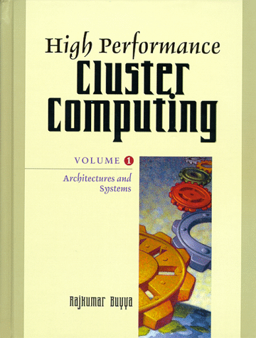
Load Sharing and
Fault Tolerance Manager
Introduction
Load Sharing in Cluster Computing
Fault Tolerance by Means of Checkpointing
Integration of Load Sharing and Fault Tolerance
Related Works
Conclusion

Slide 3
Introduction (1)
Increasing need for processing power for scientific calculations
Large development of distributed information system
Makes the computation distribution over workstation networks very attractive
Notes:
등장 배경
워크 스테이션 네트웍을 이용하여 컴퓨테이션을 분산하는 방식이 등장한 배경

Slide 4
Introduction (2)
Idle workstations
  33% ~ 78% are idle time
    18 workstations over a six-month period
    workstations were free 69% of the time
    processors were free 93% of the time

Slide 5
Introduction (3)
To achieve high performance
  To provide an efficient mechanism for program allocation
Tow load sharing policies
Dynamic placement
Migration
Notes:
결국, 고성능 컴퓨테이션을 이루기 위해서는,
이러한 idle 워크스테이션을 효과적으로 이용할 수 있도록 프로그램을 할당 할 수 있는 효과적인 메커니즘이 필요하다.

Slide 6
Introduction (4)
Dynamic placement
  Allocate programs according to the current system state
Migration
  Move processes according to system and application evolution

Slide 7
Introduction (5)
Load sharing is dedicated to long-lived application
Hardware failure, reboot, disconnected from the network
Fault tolerance becomes an essential component

Slide 8
Introduction (6)
Main scope of this chapter
  Interaction between load balancing and fault tolerance in a cluster
  The combination of the two facilities can outperform reliable parallel applications

Slide 9
Load Sharing in Cluster Computing (1)
Optimum load sharing strategies are very hard to implement and are well-known as NP-complete
  It is impossible to get an exact knowledge of the global state of the system at a given instant
  The execution of complex allocation algorithms may represent a heavy burden
  The instability behavior of allocation algorithms is due to the inaccurate information
Notes:
Instability : 불안정
3번째는 1번이 원인이다...

Slide 10
Load Sharing in Cluster Computing (2)
Parallel program placement
  Static allocation
    Adapted for multiprocessor system
    PVM
  Dynamic load sharing
    Dynamic placement
      processes are allocated at start-up and stay on the same location
    Process migration
      processes can move according to overhead conditions or the reactivation of workstations by their owners
Notes:
Static allocation : 단점은 즉, 동적 로드 발란싱이 안된다.
Dynamic placement : start-up 때 프로세스가 할당되고, 동일한 위치에서 머문다.
Process migration : 오버로드 조건이나 reboot등으로 프로세스가 이동한다.

Slide 11
Checkpointing a Single Process
A snapshot of the process’s address space at a given time
To reduce the cost of checkpointing
  Incremental method
    reduce the amount of data that must be written
  Non-blocking method
    allow the process to continue executing while its checkpoint is written to stable storage
    internal copy-on-write memory protection
Notes:
Snapshot을 저장
Incremental method
마지막 체크 포이트에서 변화된 부분만 write
Non-blocking method
checkpoint 를 하면서도 프로세스가 계속실행 할 수 있다.
Copy-on-write
체크포인트 도중에 프로세스가 메모리페이지를 변경하면 정확한 상태를 나타낼 수 없다. 체크포인트 중에는 메모리페이지를 보호하기 위한 메커니즘이 필요하다. 만약 체크포인트 메모리 페이지를 변경하려고 하면 이 페이지를 새로운 페이지에 복사하고, 원본의 프로텍션을 제거된다.
Checkpoint manager가 복사본을 종료한다.

Slide 12
Checkpointing of Communicating Processes
To recover from a fault
  the execution must be rolled back to a consistent global state
Rolling back of one process
is result in
Rollbacks of other processes
Notes:
Fault을 recovery하기 위해서는,
일관된 global 상태로 roolback 되어야 한다.
즉, 자신이 roolback이 전체 시스템의 일관성을 유지하기 위해 다른 프로세스들의 roolback을 유발시킨다.

Slide 13
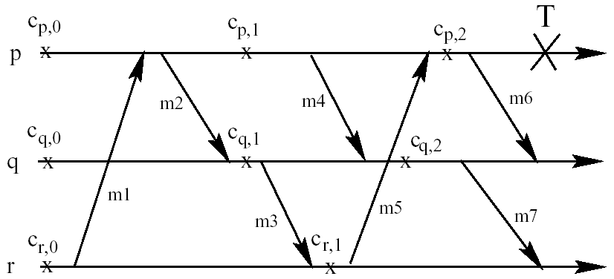
Domino Effect

Slide 14
Checkpointing Techniques (1)
Coordinated checkpointing
  Processes coordinate their checkpointing actions such that the collection of checkpoints represents a consistent state of the whole system
  Drawback
    the messages used for synchronizing a checkpoint are important source of overhead
    surviving processes may have to rollback to their latest checkpoint in order to remain consistent with recovering processes
  Analyzing the interactions between processes can reduce the number of processes to rollback
Notes:
Checkpointing 기술은 두가지로 분류될 수 있다.

Slide 15
Checkpointing Techniques (2)
Independent checkpointing
  Each process independently saves its state without any synchronization with the others
  Message logging to avoid the domino effect
  At each new checkpoint all messages are deleted from the associated backup
  The main drawback is the input/output overhead
Notes:
Checkpointing 기술은 두가지로 분류될 수 있다.

Slide 16
Checkpointing Techniques (3)
Independent checkpointing
  Two classes of logging message
    Pessimistic message logging
      Write incoming messages to stable storage before delivering to the application
      To restart, the failing process is rolled back to the last checkpoint and replies to outgoing messages are returned immediately from the log
    Optimistic message logging
      Messages are tagged with the information that allows the system to keep track of the inter-process dependencies
      Reduces logging overhead, but processes that survive a failure may still be rolled back
      Alternatively, messages are gathered in the main memory of the sending host and are asynchronously saved to stable storage
Notes:
Checkpointing 기술은 두가지로 분류될 수 있다.

Slide 17
Integration of Load Sharing and Fault Tolerance
GATOSTAR
  Fault tolerant load sharing facility
  GATOS is a load sharing manager which automatically distributes parallel applications among hosts according to multicriteria algorithms
  STAR is a software fault manager which automatically recovers processes affected by host failures
GATOS
STAR
GATOSTAR

Slide 18
Environment and Architecture (1)
System Environment
  BSD Unix OS (SunOS)
  Works on a set of heterogeneous workstations connected by a LAN
  Migration domains of compatible hosts, where processes can freely move
  The average crash time in a LAN to be once every 2.7 days for a LAN of 10 workstations
  Fail-silent processor
    the faulty nodes simple stop and the remote nodes are not notified
Notes:
Migration domains : 이 범위에서 프로세스는 자유롭게 이동할 수 있다.

Slide 19
Environment and Architecture (2)
Application model
  Application is a set of communicating processes connected by a precedence graph
  The graph contains all qualitative information needed to execute the application and helpful for the load sharing manager
    precedence and communication between processes
    files in use
  Application running for extended periods of time
    high number factoring, VLSI application, image processing
    the failure probability becomes significant
    load sharing and the need for reliability are important concerns
Notes:
Precedence graph에는 애플리케이션을 실행하고 load sharing manager에 도움이 되는 모든 정보를 포함하고 있다.

Slide 20
Environment and Architecture (3)
GATOSTAR architecture
  A ring of hosts which exchange information about hosts functioning and processes’ execution
  Automatically recover the system and quickly return it to operation, thus increasing the availability of the distributed system resources
  Each host maintains a load vector
    A view of all host loads
    Periodically, each host sends its vector to its immediate successor
    Load messages are also used to detect host failure

Slide 21
Environment and Architecture (4)
GATOSTAR architecture
  Four daemons running on each host
    LSM - a load sharing manager
      in charge of allocation and migration strategies
    FTM - a fault tolerance manager
      responsible of checkpointing and message redirection
    RM - a ring manager
      in charge of load transmission and failure detection
    RFM - a replicated file manager
      implements the reliable storage
Notes:
LSM - allocation 과 migration 전략을 책임진다.
FTM - checkpointing 과 message redirection
RM - load 전송 failure detection
RFM - reliable storage

Slide 22
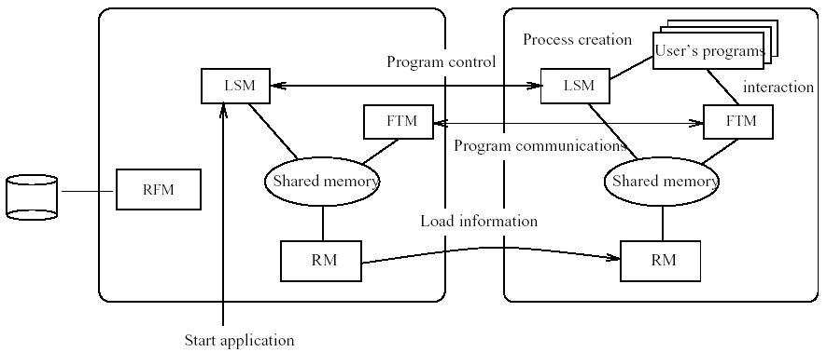
Gatostar Architecture

Slide 23
Process Allocation (1)
Process Placement
  To evaluate the need of each process
    keep track of previous executions and/or we allow application designers to give appropriate indications
  Dynamic process allocation can be operated according to the following criteria
    hosts load, process execution time, required memory, and communication between processes
  In the application description, the programmer can specify appropriate allocation criteria for each program according to its execution needs
  Specifies the set of hosts involved in the load distribution and provides different binary code versions for each program in order to deal with system heterogeneity

Slide 24
Process Allocation (2)
Selecting the less loaded host
  Allocating processes according to load allows us to benefit from idle workstation power
  Load of host
    directly proportional to CPU utilization
    inversely proportional to its CPU speed
  On each host, the load sharing manager (LSM) locally computes an average load and uses failure detection messages to exchange load information
  The program is allocated to the most lightly loaded host, if the load of this host is below the overload threshold
  Otherwise, the program is started on the originating host as all hosts in the system are heavily loaded, or used by interactive users

Slide 25
Process Allocation (3)
Selecting the less loaded host
  Main difficulty
    Find a good value for the overload threshold
    Get global state information
      Every host cannot have exact knowledge about the load of the other hosts
        network transmission time
        delay between the instant when a host receives the information and the instant it uses the information to decide where to allocate a process
  Large load fluctuations can occur unexpectedly
    If the delays mentioned above are significant, a program can be allocated to a host, which becomes heavily loaded
      Re-directing the program allocation request, if the load of selected host is higher than the overload threshold

Slide 26
Process Allocation (4)
Multicriteria load sharing algorithm
  Response time
    aims at minimizing the total execution time of the whole application
    the selected hosts are allocated to programs in the order of their decreasing execution time values
    the longest programs are allocated on the less loaded and fastest hosts
Notes:
애플리케이션 실행과 관련된 여러 기준을 고려하여 프로그래머가 program placement 정책을 결정할 수 있다.
Application description 에 프로그래머가 각 프로그램에 적절한 성능 기준 (criteria) 을 설정할 수 있다.
GATOSTAR에서 제안하는 표준
response time : 어플리케이션의 전체 실행 시간을 최소화 하는데 목적이 있다. Parallel program들을 배치작업으로 실행한다. 가장 긴 실행시간을 갖는 프로그램을 먼저 실행시킨다.. 계속 내림 차순으로 하도록 제안하는 것이다.
File access :전체 파일 액세스 시간을 최소화 하도록 프로그램을 할당.
액세스 수, 파일 액세스 크기, 디스크와 네트웍 속도등 여러 파라미터를 기반으로 결정하고, 그 이후에 migration 이나 remote access 로 나머지 파일을 참조
communication between programs : 전체 통신 비용을 최소화, 이미 시스템에 할당된 프로그램들의 위치 정보를 가지고 있어야 한다.
Memory need : batch queue system을이용 : 적당한 메모리 공간이 제공될 때까지 기다린다. 애플리케이션이 올바르게 실행을 보장하지만, response time이 증가된다.
Performance criteria combination : 동시에 위의 여러정책을 조합하고 이를 적용하여 가장 적당한 호스트를 선택하여 프로그램을 할당한다

Slide 27
Process Allocation (5)
Multicriteria load sharing algorithm
  File accesses
    finding the host where a program should be allocated so that the total cost of file accesses is minimized
    the allocation decision is based on a number of parameters
      number of access, size of file accesses, disks and network speed
    to decide whether to migrate one or more of the remaining files or to access them remotely (according to the previous parameters and the file size)
Notes:
애플리케이션 실행과 관련된 여러 기준을 고려하여 프로그래머가 program placement 정책을 결정할 수 있다.
Application description 에 프로그래머가 각 프로그램에 적절한 성능 기준 (criteria) 을 설정할 수 있다.
GATOSTAR에서 제안하는 표준
response time : 어플리케이션의 전체 실행 시간을 최소화 하는데 목적이 있다. Parallel program들을 배치작업으로 실행한다. 가장 긴 실행시간을 갖는 프로그램을 먼저 실행시킨다.. 계속 내림 차순으로 하도록 제안하는 것이다.
File access :전체 파일 액세스 시간을 최소화 하도록 프로그램을 할당.
액세스 수, 파일 액세스 크기, 디스크와 네트웍 속도등 여러 파라미터를 기반으로 결정하고, 그 이후에 migration 이나 remote access 로 나머지 파일을 참조
communication between programs : 전체 통신 비용을 최소화, 이미 시스템에 할당된 프로그램들의 위치 정보를 가지고 있어야 한다.
Memory need : batch queue system을이용 : 적당한 메모리 공간이 제공될 때까지 기다린다. 애플리케이션이 올바르게 실행을 보장하지만, response time이 증가된다.
Performance criteria combination : 동시에 위의 여러정책을 조합하고 이를 적용하여 가장 적당한 호스트를 선택하여 프로그램을 할당한다

Slide 28
Process Allocation (6)
Multicriteria load sharing algorithm
  Communication between programs
    aims to minimize the total cost of communications between programs
    to reduce the number of remote communications
    keep information of the location of all the application’s programs already allocated in the system
Notes:
애플리케이션 실행과 관련된 여러 기준을 고려하여 프로그래머가 program placement 정책을 결정할 수 있다.
Application description 에 프로그래머가 각 프로그램에 적절한 성능 기준 (criteria) 을 설정할 수 있다.
GATOSTAR에서 제안하는 표준
response time : 어플리케이션의 전체 실행 시간을 최소화 하는데 목적이 있다. Parallel program들을 배치작업으로 실행한다. 가장 긴 실행시간을 갖는 프로그램을 먼저 실행시킨다.. 계속 내림 차순으로 하도록 제안하는 것이다.
File access :전체 파일 액세스 시간을 최소화 하도록 프로그램을 할당.
액세스 수, 파일 액세스 크기, 디스크와 네트웍 속도등 여러 파라미터를 기반으로 결정하고, 그 이후에 migration 이나 remote access 로 나머지 파일을 참조
communication between programs : 전체 통신 비용을 최소화, 이미 시스템에 할당된 프로그램들의 위치 정보를 가지고 있어야 한다.
Memory need : batch queue system을이용 : 적당한 메모리 공간이 제공될 때까지 기다린다. 애플리케이션이 올바르게 실행을 보장하지만, response time이 증가된다.
Performance criteria combination : 동시에 위의 여러정책을 조합하고 이를 적용하여 가장 적당한 호스트를 선택하여 프로그램을 할당한다

Slide 29
Process Allocation (7)
Multicriteria load sharing algorithm
  Memory needs
    the host on which a program will be allocated must have enough memory to run it
      by determining the memory needs of the program to be allocated and the available memory on every host
    program allocation on one host must not exceed the maximum physical memory of this host
    The memory allocation criterion in GATOSTAR
      Programs are managed by a batch queue system, waiting for the appropriate memory space to be available
        this ensures the correct execution of the application but may increase its response time
Notes:
애플리케이션 실행과 관련된 여러 기준을 고려하여 프로그래머가 program placement 정책을 결정할 수 있다.
Application description 에 프로그래머가 각 프로그램에 적절한 성능 기준 (criteria) 을 설정할 수 있다.
GATOSTAR에서 제안하는 표준
response time : 어플리케이션의 전체 실행 시간을 최소화 하는데 목적이 있다. Parallel program들을 배치작업으로 실행한다. 가장 긴 실행시간을 갖는 프로그램을 먼저 실행시킨다.. 계속 내림 차순으로 하도록 제안하는 것이다.
File access :전체 파일 액세스 시간을 최소화 하도록 프로그램을 할당.
액세스 수, 파일 액세스 크기, 디스크와 네트웍 속도등 여러 파라미터를 기반으로 결정하고, 그 이후에 migration 이나 remote access 로 나머지 파일을 참조
communication between programs : 전체 통신 비용을 최소화, 이미 시스템에 할당된 프로그램들의 위치 정보를 가지고 있어야 한다.
Memory need : batch queue system을이용 : 적당한 메모리 공간이 제공될 때까지 기다린다. 애플리케이션이 올바르게 실행을 보장하지만, response time이 증가된다.
Performance criteria combination : 동시에 위의 여러정책을 조합하고 이를 적용하여 가장 적당한 호스트를 선택하여 프로그램을 할당한다

Slide 30
Process Allocation (8)
Multicriteria load sharing algorithm
  Performance criteria combination
    to ensure program placement according to several policies at the same time
    take at the beginning the set of available hosts, then, this set is reduced according to the first criterion on the given list of criteria
    this mechanism is repeated with the remaining criteria until only one host remains or all the refinements have been done
    multicriteria approach is very efficient for a general-purpose load sharing system
      it can adapt the allocation to a wide spectrum of applications and programs behaviors
Notes:
애플리케이션 실행과 관련된 여러 기준을 고려하여 프로그래머가 program placement 정책을 결정할 수 있다.
Application description 에 프로그래머가 각 프로그램에 적절한 성능 기준 (criteria) 을 설정할 수 있다.
GATOSTAR에서 제안하는 표준
response time : 어플리케이션의 전체 실행 시간을 최소화 하는데 목적이 있다. Parallel program들을 배치작업으로 실행한다. 가장 긴 실행시간을 갖는 프로그램을 먼저 실행시킨다.. 계속 내림 차순으로 하도록 제안하는 것이다.
File access :전체 파일 액세스 시간을 최소화 하도록 프로그램을 할당.
액세스 수, 파일 액세스 크기, 디스크와 네트웍 속도등 여러 파라미터를 기반으로 결정하고, 그 이후에 migration 이나 remote access 로 나머지 파일을 참조
communication between programs : 전체 통신 비용을 최소화, 이미 시스템에 할당된 프로그램들의 위치 정보를 가지고 있어야 한다.
Memory need : batch queue system을이용 : 적당한 메모리 공간이 제공될 때까지 기다린다. 애플리케이션이 올바르게 실행을 보장하지만, response time이 증가된다.
Performance criteria combination : 동시에 위의 여러정책을 조합하고 이를 적용하여 가장 적당한 호스트를 선택하여 프로그램을 할당한다

Slide 31
Process Allocation (9)
Process Migration
  Three main questions that must be answered
    when to migrate a process
      a migration threshold
    which process to choose
      local server chooses a process that has been executed locally for at least a given local execution time
    where to move the chosen process
      a reception threshold
Notes:
Migration시에 결정해야할 3가지 요소
“when to migrate a process”는 a migration threshold를 기반으로 결정하고,
“where to more the chosen process”는 a reception threshold를 기반으로 결정한다.

Slide 32
Process Allocation (10)
Process Migration
  Load sharing server periodically computes two conditions
    a faster workstation load is under the reception threshold
    the local host load is above the migration threshold and at least one workstation load is under the reception threshold
Notes:
1번째; 빠른호스트를 이용할 수 있는 잠재성을 보여준다.
2번째: 로컬의 로드를 감소시킬수 있는 방법이 있다는 것을 보여준다.

Slide 33
Failure Management (1)
Failure detection mechanism
  a structuring of hosts in a logical ring
  each host independently checks its successor
Recovery method
  checkpoint/rollback management
    user processes save their states to prevent their local host failures
  independent checkpointing with a pessimistic message logging
    adapted for application composed of processes exchanging small streams of data

Slide 34
Failure Management (2)
Recovery method
  Advantages
    the domino-effect is eliminated
    checkpoint operation can be performed unilaterally by each process and any checkpointing policy may be used
    only one checkpoint is associated to each process
    checkpoint cost is lower than in a consistent checkpointing and recovery is implemented efficiently because all interprocess communications do not take place during a replay
  GATOSTAR implements incremental and non-blocking checkpointing

Slide 35
Performance Study (1)
Cost of initial placement
  Hosts selection is done locally when starting the application, and the only exchange of message is the request from the local load sharing manager to the remote one to execute a given program
Cost of process migration
  The time for a process migration is proportional to the amount of data to be transferred from the source host to the selected one
  The size of each test process is less than 100 kilobytes
  Migration time of these processes is less than 3 seconds

Slide 36
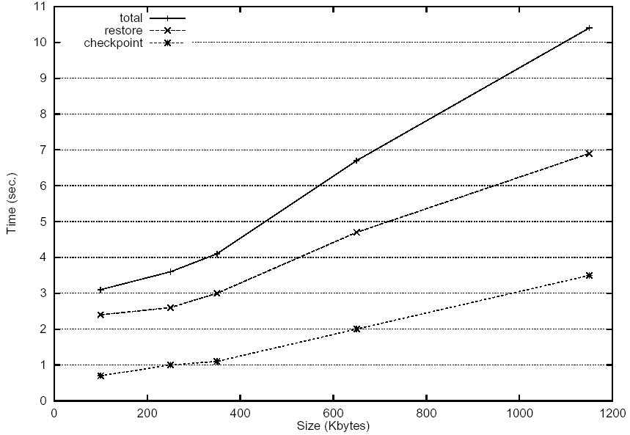
Migration Time According to Process Size

Slide 37
Performance Study (2)
Process allocation
  The execution time of six parallel programs running on six hosts
  Compare the non-preemptive placement strategy with the migration
  Each program is computing a given number of iterations, from 50 million to 500 million
  There is no communication between programs

Slide 38
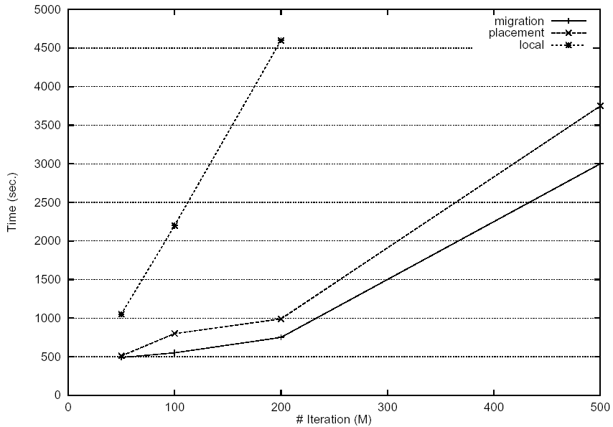
Execution Time of Six Programs According to the Number of Iterations

Slide 39
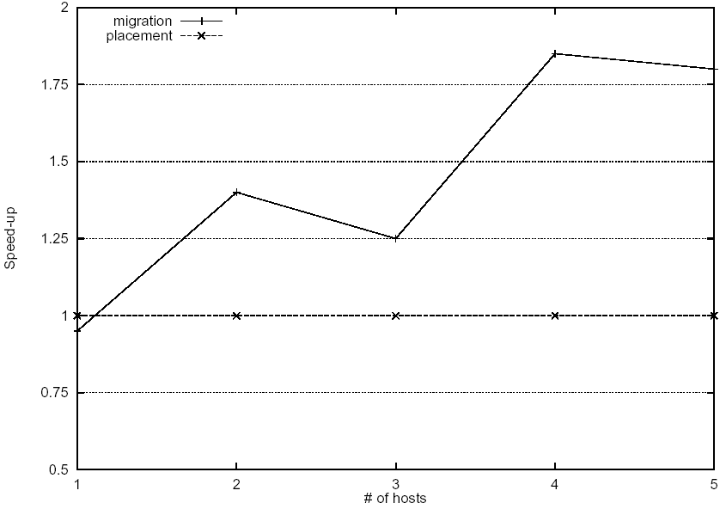
Speedup According to the Number of Hosts

Slide 40
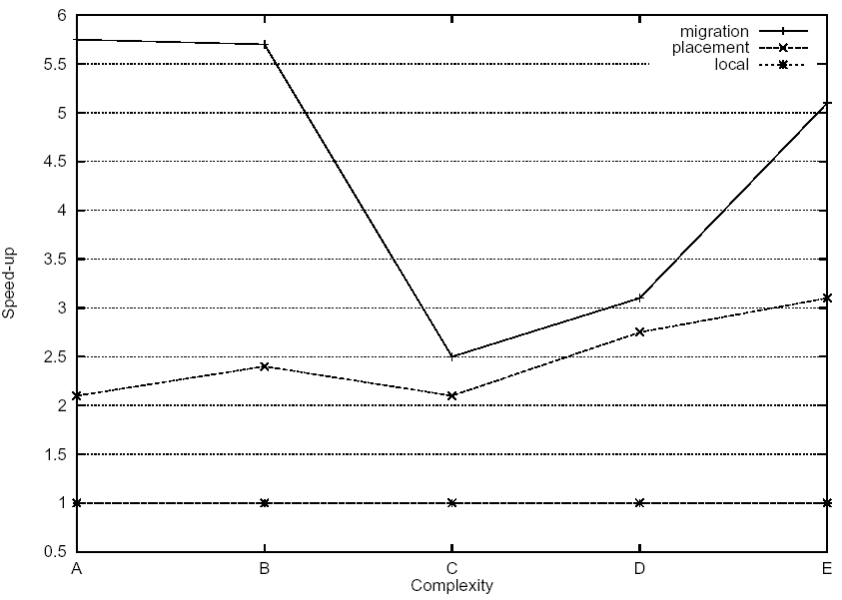
Speedup According to Application Complexity

Slide 41
Performance Study (3)
Extrapolation by simulation
  Fixed threshold vs adaptive threshold
  An allocation manager should adapt the threshold values according to the global load and the behavior of the current application

Slide 42
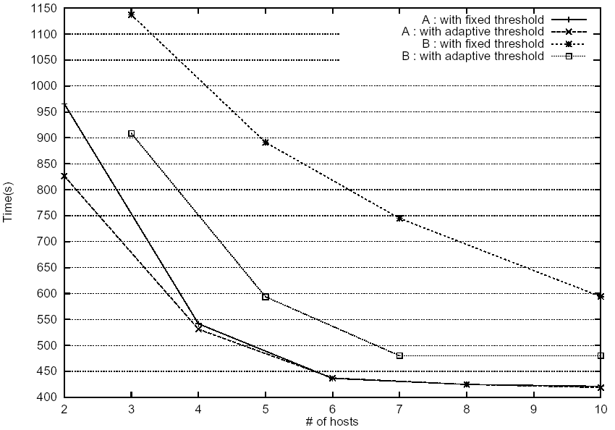
Simulation of Response Time According to the Threshold Policy

Slide 43
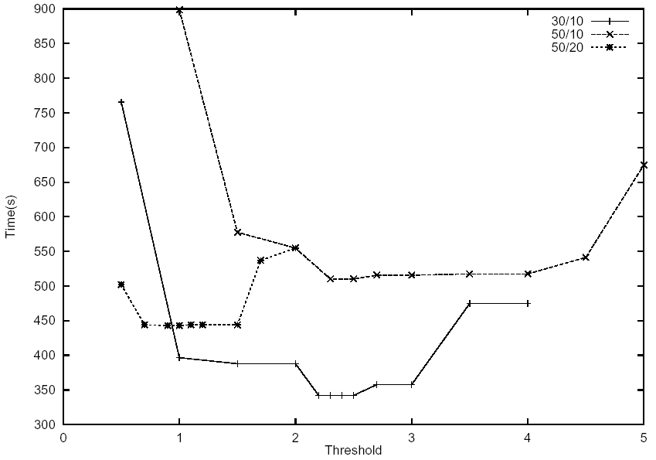
Simulation of Response Time According to the Overload Threshold Value

Slide 44
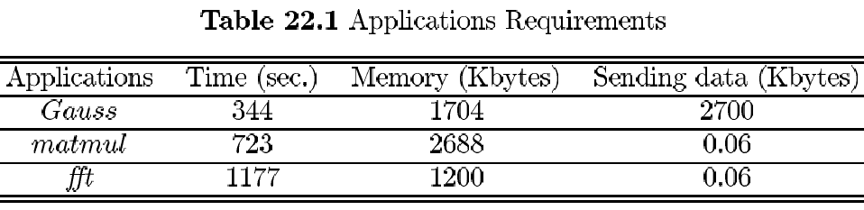
Performance Study (4)
Performance of checkpointing
  Three long-running, compute-intensive applications exhibiting different memory usage and communications patterns

Slide 45
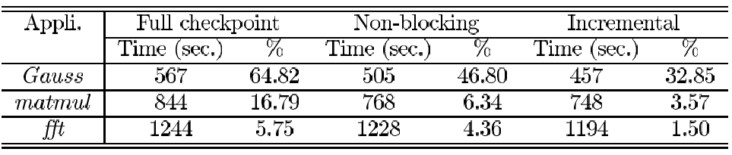
Parallel Applications Evaluation
Independent checkpointing and pessimistic message logging
2-minute checkpointing interval
Checkpointings and logs are duplicated

Slide 46
Related Works
REM, Paralex, Condor, DAWGS (Distributed Automated workload sharing System)
  Developed essentially as load sharing manager, since fault tolerance is a limited extension
  REM and Paralex are load sharing managers that support cooperative applications
  REM provides a mechanism by which processes may create, communicate, and terminate child processes on remote workstations
  Active process replication is used to ensure the fault tolerant execution of the child processes
  Failure of the local user’s machine implies a failure of the whole computation

Slide 47
Conclusion (1)
Described the advantages of load sharing and fault tolerance unification
  Improve application’s response time
  Decrease the overhead of the software fault management
GATOSTAR is a unified load sharing and fault tolerance facility
  Advantage of the overall system resources and allows the distribution of the applications processes on the most appropriate hosts
  Process allocation policy takes into account both information about the system state and resource need for the execution of applications
  A checkpoint mechanism allows the recovery of processes after hosts’ failures and is used to move processes in case of load fluctuations

Slide 48
Conclusion (2)
Show the benefit of the load sharing and of the multi-criteria allocation algorithms in a LAN of workstations
The combination of dynamic placement and process migration outperforms dynamic placement only
Dynamic placement allows us to use the available machine at launch time at very low cost (one request)
For long-lived applications, process migration allows to correct this initial placement according to failures or changes of the program behaviors, in the hosts load, or in interactive users activities

